Slide 1
Pulse width modulated rectifiers
By Stig Munk-Nielsen

Slide 2
Agenda
Ideal rectifier
Near ideal rectifier
CCM Boost Converter
Exercise 18.1

Slide 3
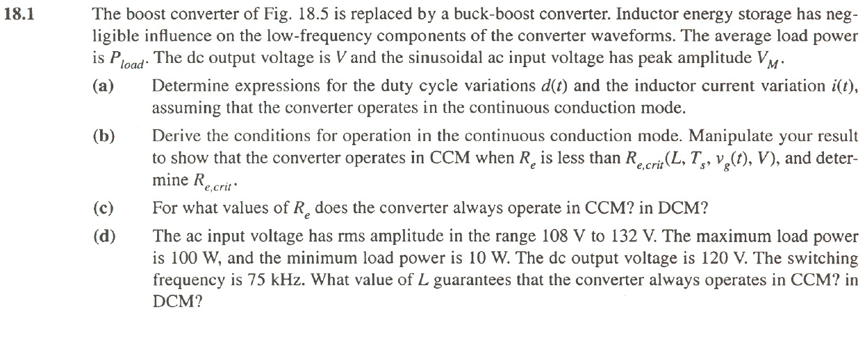
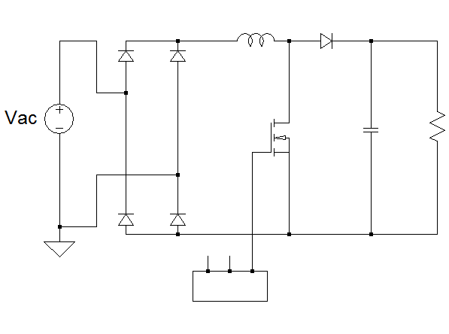
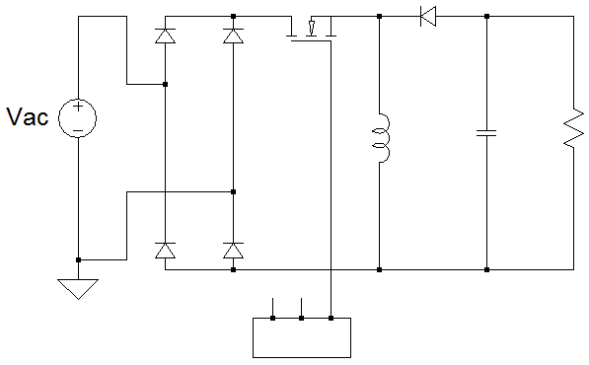
Exercise 18.1
Fig 18.5

Slide 4
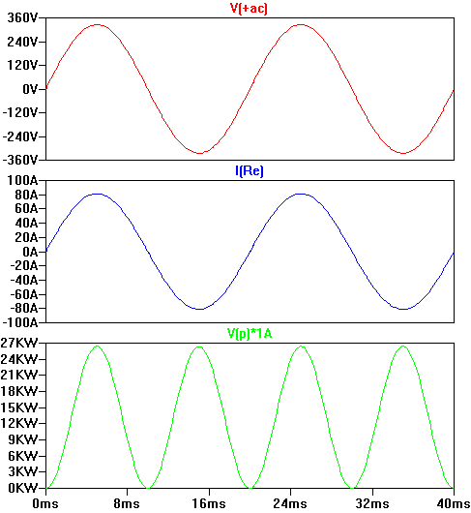
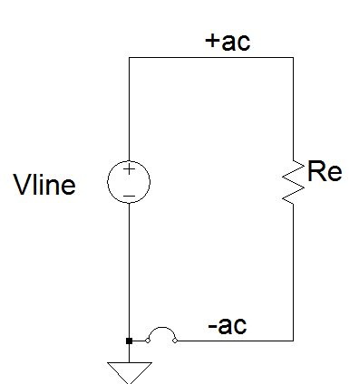
Ideal rectifier behavior: Pac = 13.2 kW

Slide 5
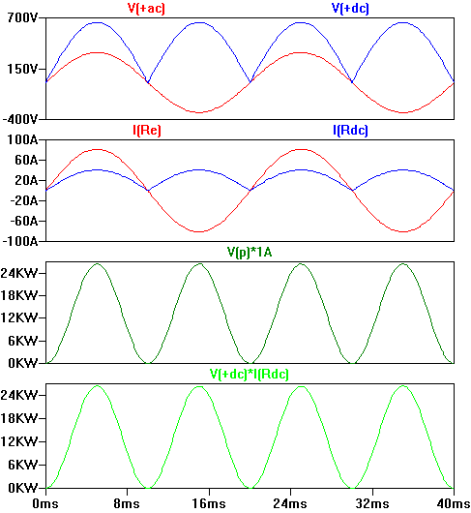
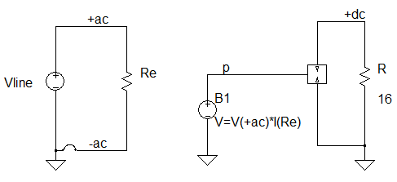
Ideal rectifier behavior (Pdc = Pac=13.2kW)
DC power pulsations with Amplitude identical to AC power amplitude!

Slide 6
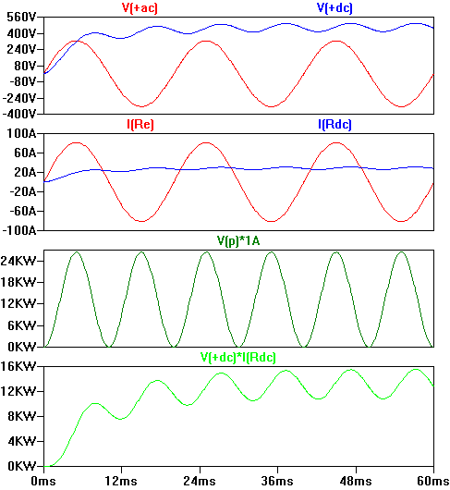
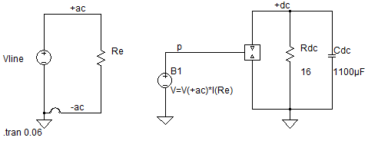
Ideal rectifier behavior (Pdc = Pac=13.2kW) with Capacitor effect.
DC power pulsations with reduced Amplitude!
Energy–storage reduce power ripple -
And reduce ripple in DC voltage

Slide 7
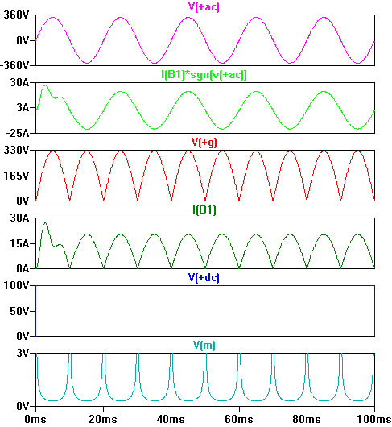
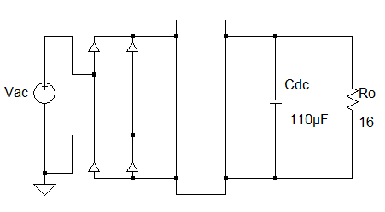
Near ideal rectifier
Vac(t)
iac(t)
iac(t)
ig(t)
i(t)
vg(t)
+
Vg(t)
-
+
Vo(t)
-
ig(t)
vo(t)
Converter
stage
M(t)
Vm = 325 V
Vo = 100 V
308 mV

Slide 8
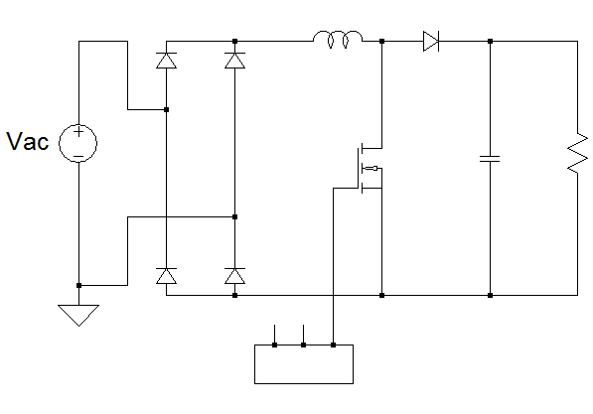
CCM Boost Converter
ig(t)= iL(t)
io(t)
+
vg(t)
-
+
Vo(t)
-
vg(t) ig(t)

Slide 9
Exercise 18.1

